Slide 1
Predicting the Severity of Road Accident

Slide 2
Introduction
More than 3000 people die in road crashes every day worldwide
substantial efforts have been made to address the main factors that cause traffic accidents, such as speeding, distracted driving, driver fatigue, road conditions, use of mobile phones, and poor weather conditions.
it is even more important to have tools and means available to mitigate the occurrences, as well as the implications and consequences they have for the people involved.

Slide 3
Data acquisition and cleaning
The data comes from governemnt website www.data.gov.uk.
We import two files to perform analysis on this data. This data is consist of two files that are accidents and casualities.
In total, 368,378 rows and 38 features in the raw dataset.
Duplicate, highly similar or highly correlated features were dropped.
Cleaned data contains 25 features.

Slide 4
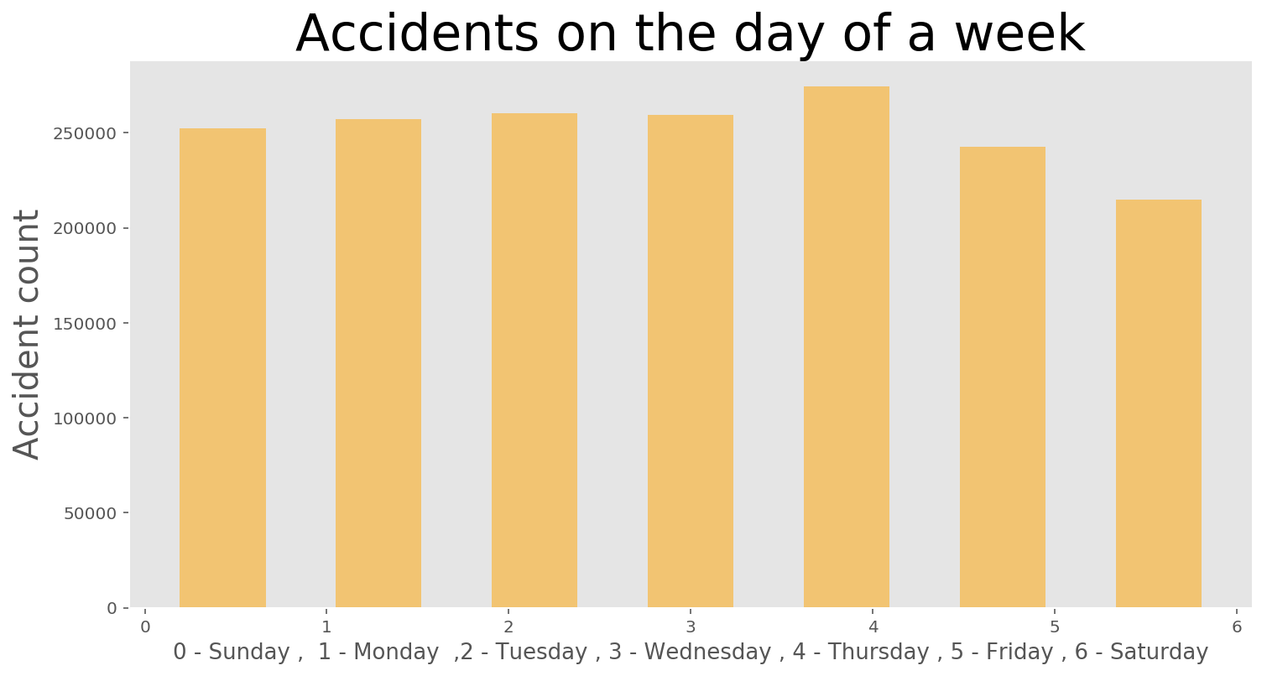
Relationship between day of a week and accident

Slide 5
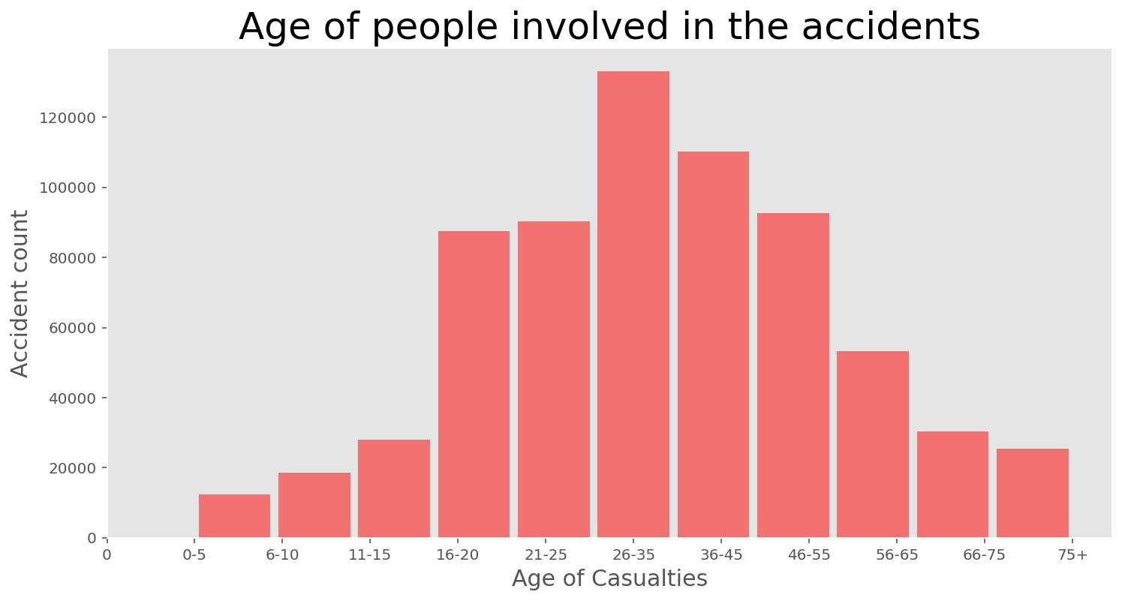
Relationship between accident and age

Slide 6
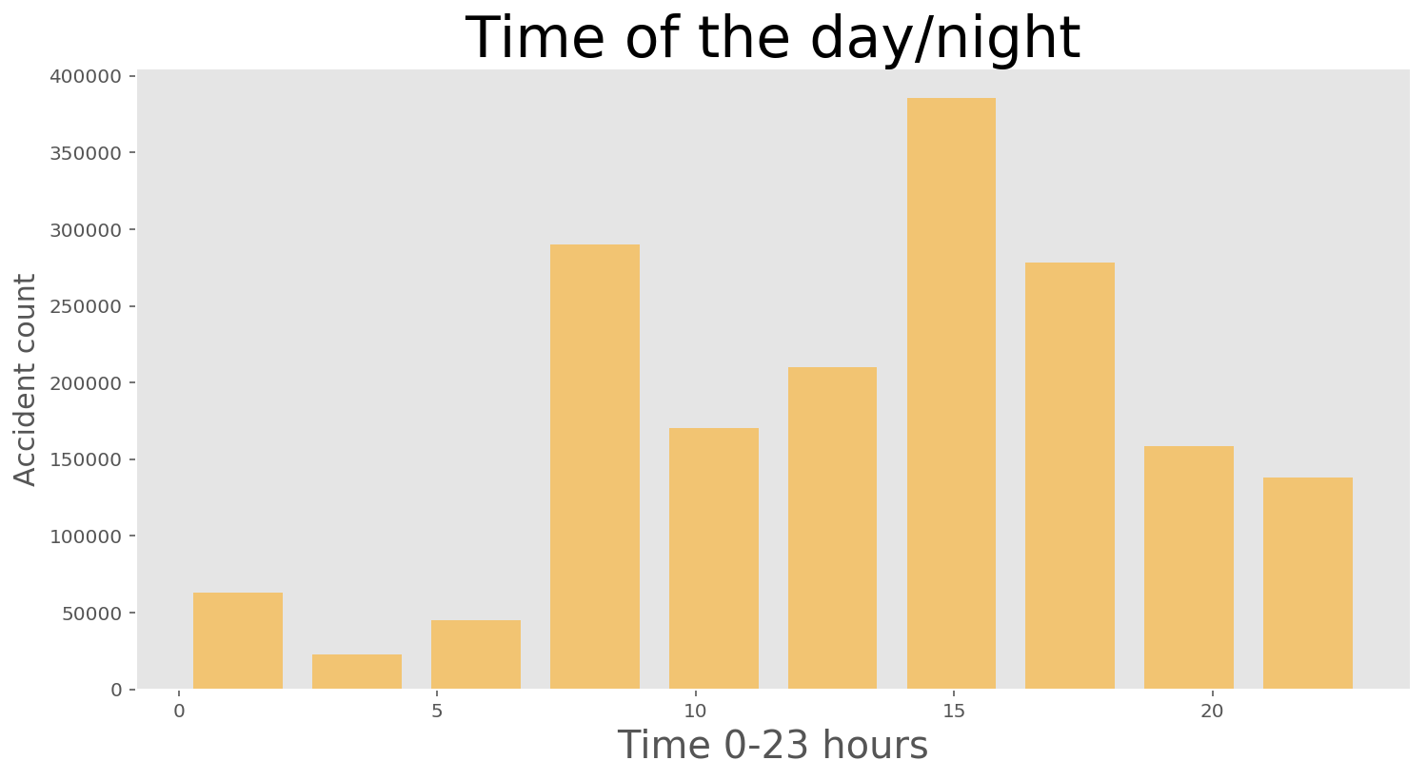
Relationship between accident and time of the day/night

Slide 7
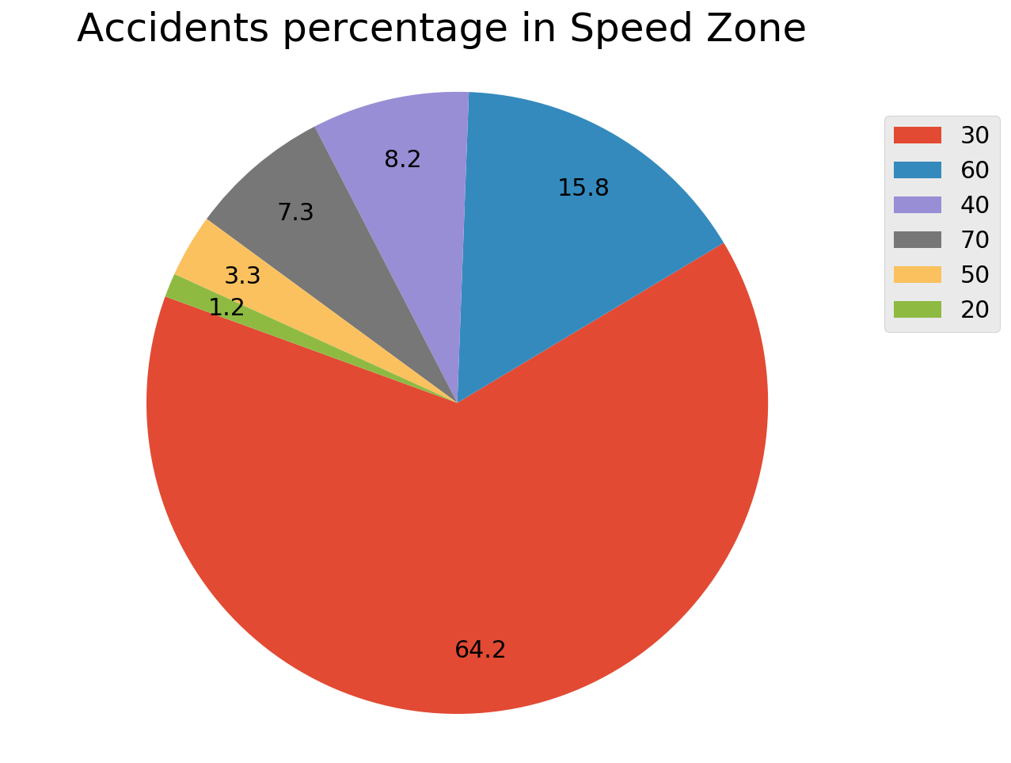
Relationship between accident and speed limit

Slide 8
Predictive Modeling
Logistic Regression
We got 84.96% accuracy using this model.
Decision Tree
We got 75.73% accuracy using this model.

Slide 9
Conclusion
It was clear that Decision tree performed much better in terms of predicting all the classes of accident severity.
Logistic regression has better accuracy but it does not mean it did better than other algorithm.
the most of the accidents occurred in an area where speed limit is 30.
most of the casualties are in age band of 25 to 35 years
We found out that the most of accidents happened around after noon

